Slide 1
Data Structure
CHAPTER 6
GRAPHS

Slide 2
HomeWorks-6-2
Given a graph G using the adjacency matrix representation. Write a program which has the following functions.
(1) transfer into an adjacency lists representation of G (40%)
(2) output depth first search; (30%)
(3) output breadth first search (30%)

Slide 3
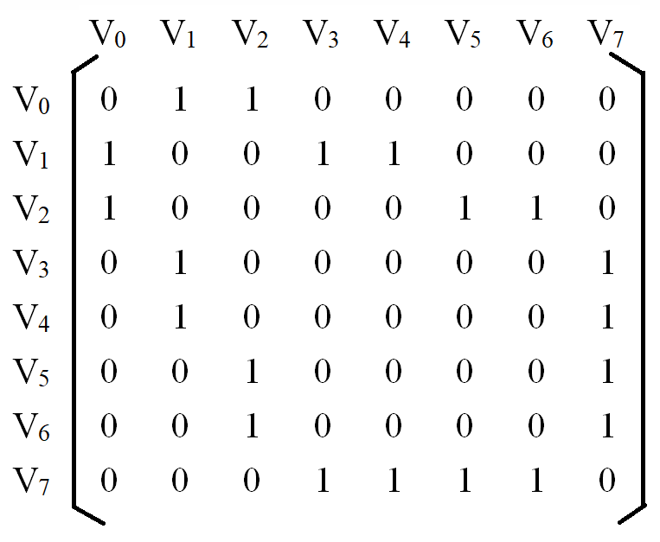
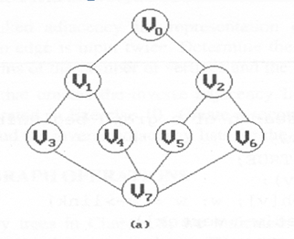
Example

Slide 4
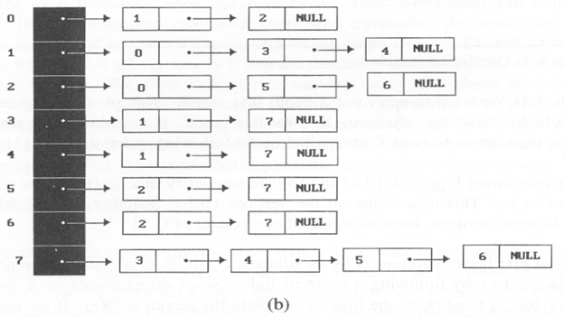
Example
Depth first search: v₀, v₁, v₃, v₇, v₄, v₅, v₂, v₆
(v₀,v₁),(v₁,v₃),(v₃,v₇),(v₇,v₄),(v₇,v₅),(v₅,v₂),(v₂,v₆)
Breadth first search: v₀, v₁, v₂, v₃, v₄, v₅, v₆, v₇
(v₀,v₁),(v₀,v₂),(v₁,v₃),(v₁,v₄),(v₂,v₅),(v₂,v₆),(v₃,v₇)

